Slide 1
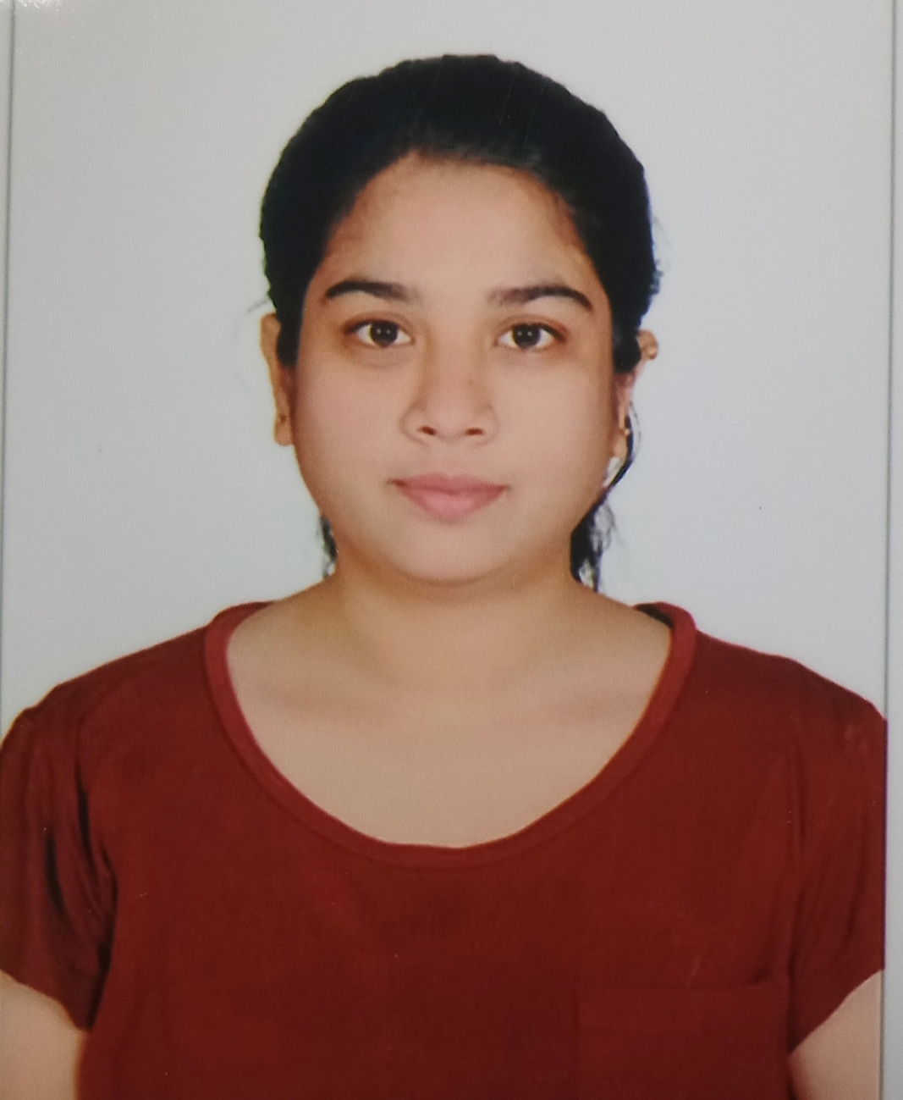

Aishwarya Patil
Bachelor of Engineering,
E&TC : 2018-22
Analyst/Software Engineer
Skills
Mumbai
C# | Basics, OOPS, Exception Handling ,Arrays ,Collection and Generics.
Angular | Components, services, Modules, Routing, Forms and Validation
.NET Framework | ADO.NET, .NET 6 WEB API, Entity Framework , ASP .NET with MVC5.
Database | SQL
Tools | GIT,POSTMAN, VISUAL STUDIO,SSMS.
UI Technology | HTML5 ,CSS & Angular
Add On Skills | Communication Skills, Team Management
aishwarya-dilip.patil@capgemini.com
+91 9049237802
A4
Full Stack Developer
Hands on experience on C#, ADO.NET, Entity Framework, SQL server, ASP.NET MVC5 with WEB API.
Experience in creating Single Page Web application in Angular. Hands on experience in developing web pages using HTML5,CSS3,Typescript,JSON.Good understanding of Document Object Model(DOM).
Understanding of RDBMS concepts using SQL Server.
Practical understanding of C# and SQL concepts using Visual Studio and SQL Server
ROLLOFF MANAGEMENT
Developed a WEB APPLICATION as part of case study using .NET WEBAPI , Swagger, responsive UI with HTML, CSS & ANGULAR used for User Interface.
It is implemented to make roll off process easier for all departments involved and reduce the repetitive tasks.
GitHub Link

